Slide 1

Exploratory Data Analysis
G2M Cab Industry Case Study
Rohit Sunku

Slide 2

AGENDA
Executive Summary
Problem Statement
Approach
EDA
EDA Summary
Recommendations

Slide 3
EXECUTIVE SUMMARY
Overview
This presentation showcases a comprehensive analysis on two different cab companies, Pink Cab and Yellow Cab. We compare these based on their profits, number of rides, areas they are based in and their number of customers which are all metrics of economic growth.
Content
We start by outlining the problem statement, and spending time analyzing the data to see what insights we can make that would be useful. There are 4 datasets, Transaction Data, Customer Data, Cab Data and Country Data which we merge to form one Master Data-Frame for analysis. Separate copies of this Data-Frame split up by each cab company for separate analysis, since there are customers which have used companies. The data is checked for null and duplicate values.
We then start our Exploratory Data Analysis, with a correlation heatmap showing feature relations and presenting model ideas, followed by a Geospatial Analysis of profits and customer counts. We use Tableau, Excel and Python to create visuals presenting our analysis and insights.
We finish our analysis with Hypothesis Testing, testing out 6 different hypotheses before summarizing our analysis and giving final recommendations.

Slide 4
PROBLEM STATEMENT
XYZ is a private equity firm within the USA
Due to remarkable growth within the Cab Industry, XYZ would make an investment into the Cab Industry; there are multiple key players in the market currently
359,431 data points
0 null values and 0 duplicate values
Our objective is to provide actionable insights to influence the correct driven investment decision made by the XYZ firm.

Slide 5
EDA

Slide 6
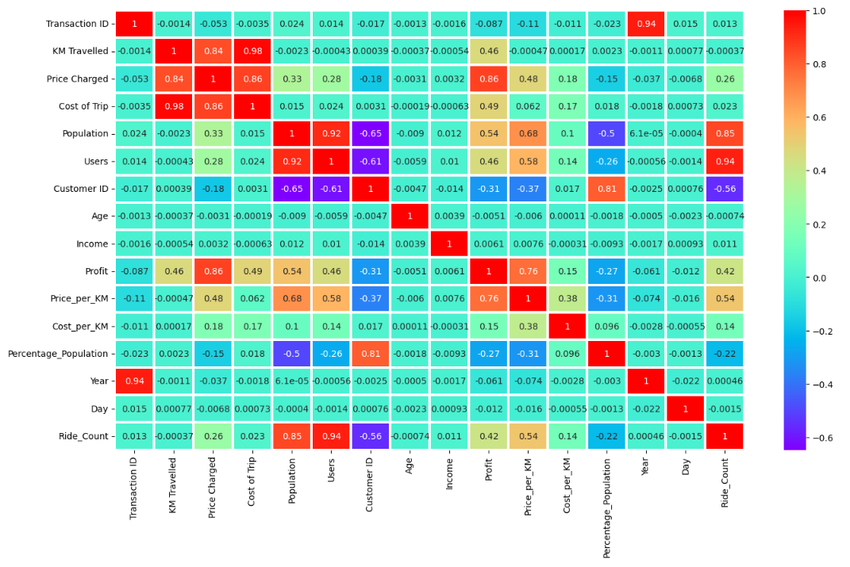
CORRELATION HEATMAP
We observe the correlation coefficients for each variable in the form of a Heatmap. To build models, we need to use PCA to address collinearity of variables.
Profit Model Variables: KM Travelled, Price Charged, Cost of Trip, Population, Users, Customer ID, Price per KM, Percentage Population, Price Count
Ride Count Model Variables: Price Charged, Population, Users, Customer ID, Profit, Price per KM, Percentage Population
We can use these variables above the 20% Correlation Threshold to create the models.

Slide 7
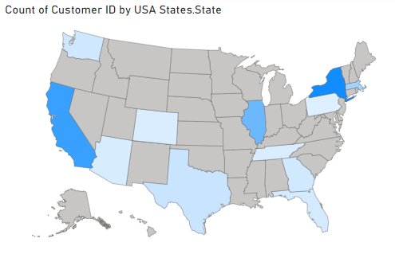
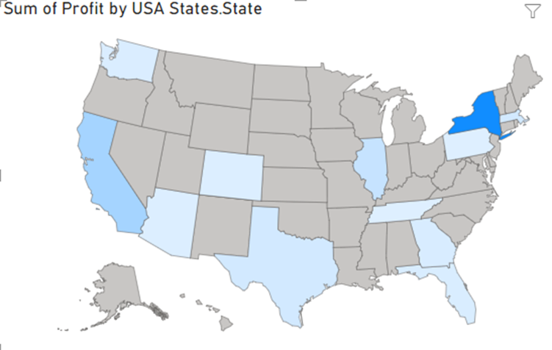
GEOSPATIAL ANALYSIS
We can see that Customer counts are highest in New York, California and then Illinois, respectively
Many flyover States have no customers; Cab Companies can increase their diversity and build their customer base in other states, starting with moving down the West Coast, looking at Pennsylvania, Maryland, Virginia, North Carolina and South Carolina.
New York is the most profitable State, due to its dense shading on the Geospatial Plot. California and Illinois do not make as much Profit as New York per their Customer and need to start increasing their prices to match this.
Other States include Texas, Arizona, Colorado, Washington, Georgia, Tennessee and Massachusetts.

Slide 8
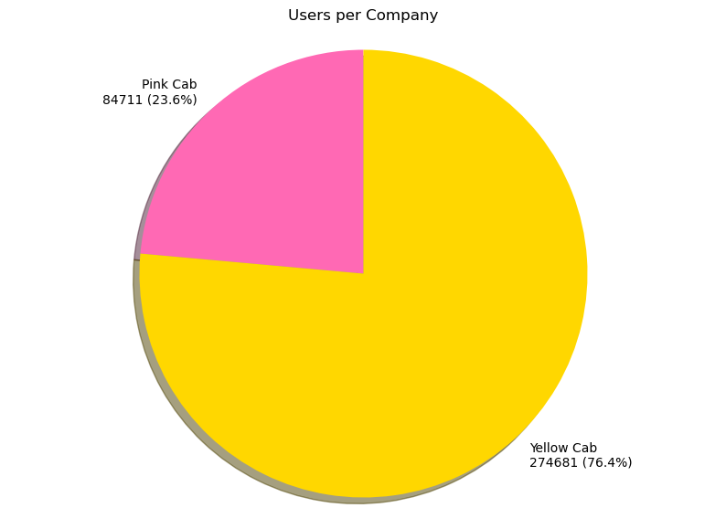
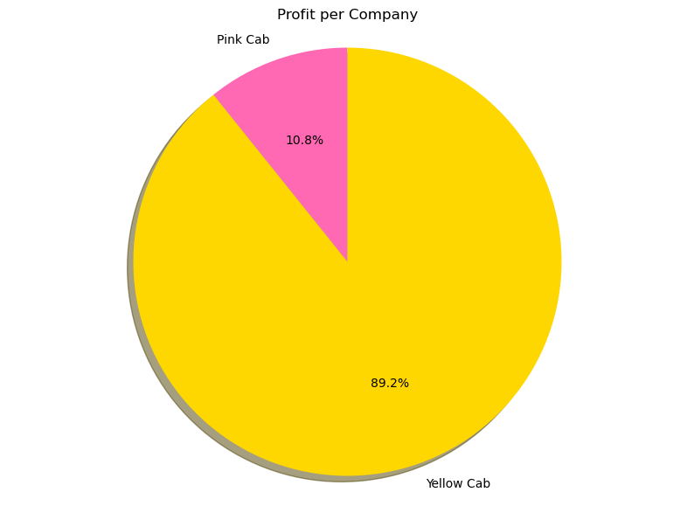
USERS & PROFIT PER COMPANY
76.4% of total users use the Yellow Cab service, compared to 23.6% for the Pink Cab service, highlighting Yellow Cab’s market dominance.
Furthermore, Yellow Cab’s profits accounted for almost 90%, which is higher than the percentage of Users, emphasizing the company’s high economic performance and ability to generate profits.
From this information alone, we can conclude Yellow Cab is a better company to invest in, however let us delve deeper.

Slide 9
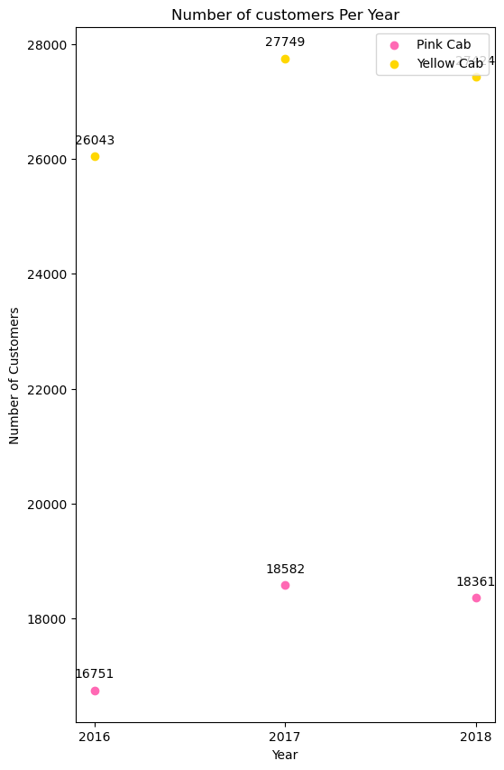
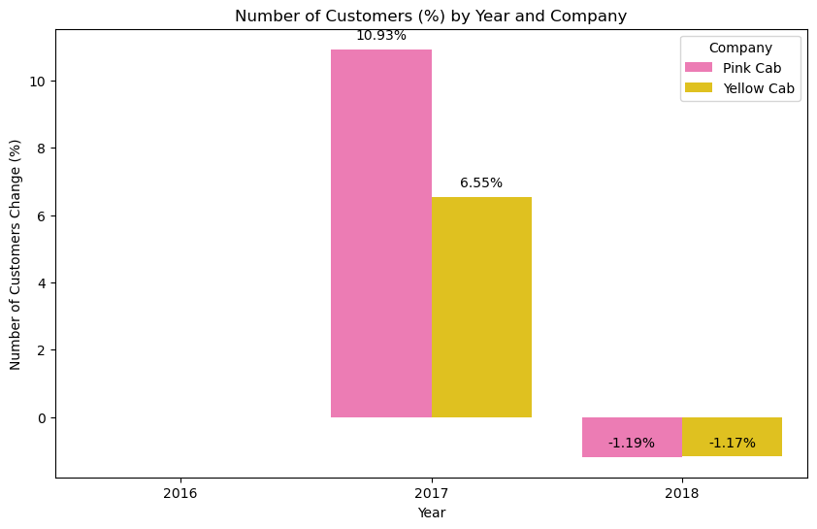
ANALYSING CUSTOMER COUNT CHANGES
From 2016 to 2017, Pink Cab saw a greater increase in the percentage of new rides at 19.46% and a smaller percentage change drop of rides from 2017 to 2018 at 3.26%.
However, Pink Cab rides counts are much smaller with Yellow Cab more than triple the number of rides.
2017 records the highest usage of these cab services, with a large influx from 2016, and a small decrease in 2018.
According to Percentage Changes alone, Pink Cab is a better investment, due to larger percentage increases and smaller percentage decreases in the number of rides by year.

Slide 10
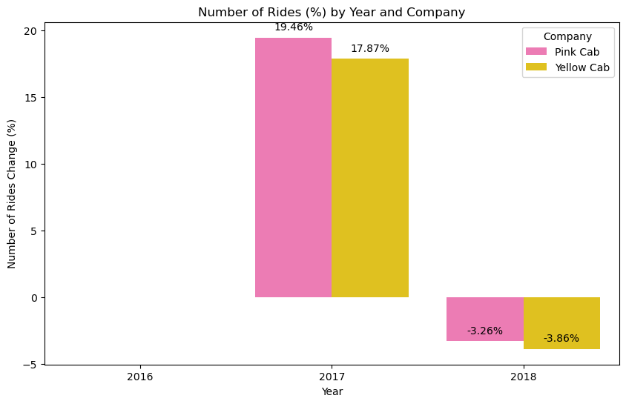
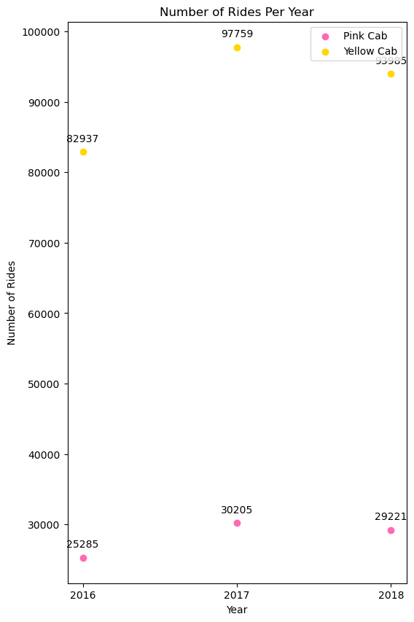
ANALYSING TRANSACTION COUNT CHANGES
From 2016 to 2017, Pink Cab saw a greater increase in the percentage of new rides at 19.46% and a smaller percentage change drop of rides from 2017 to 2018 at 3.26%.
However, Pink Cab rides counts are much smaller with Yellow Cab more than triple the number of rides.
2017 records the highest usage of these cab services, with a large influx from 2016, and a small decrease in 2018.
According to Percentage Changes alone, Pink Cab is a better investment, due to larger percentage increases and smaller percentage decreases in the number of rides by year.

Slide 11
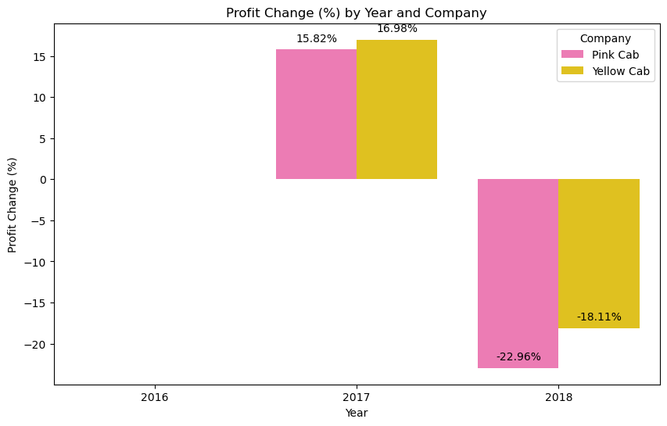
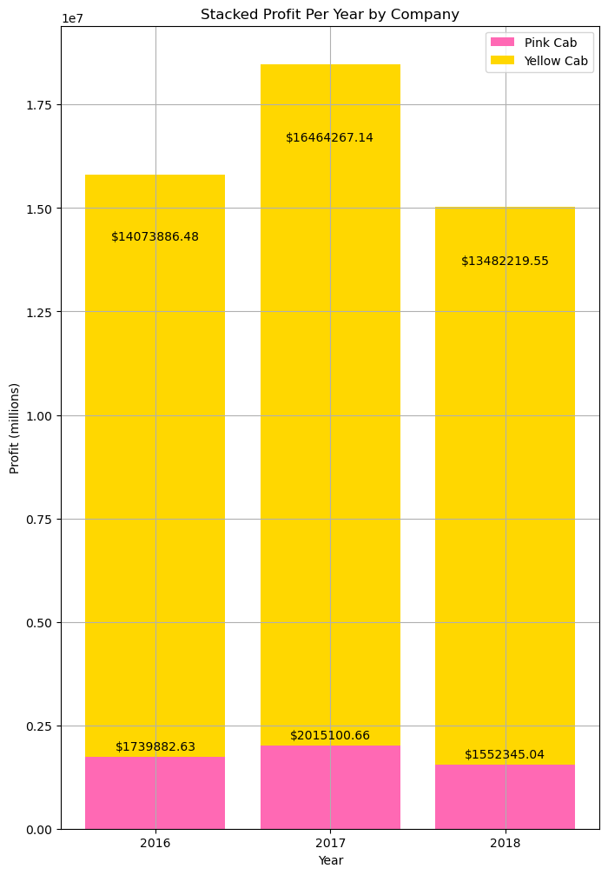
ANALYSING PROFIT CHANGE
Yellow Cab’s profit percentage change increase was 1.16% higher from 2016 to 2017.
Yellow Cab’s profit percentage change decrease was 4.85% higher from 2017 to 2018.
Overall Yellow Cab Profit is significantly higher each year; Yellow Cab consistently has over $10 million more profit than Pink Cab
Yellow Cab is more profitable, and a better long-term investment, due to smaller fluctuations in Net Worth.

Slide 12
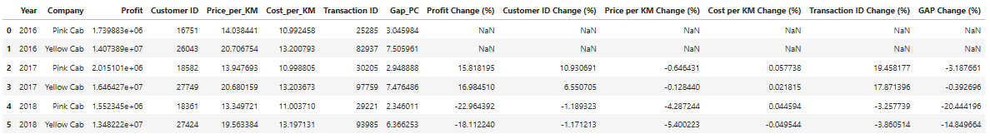
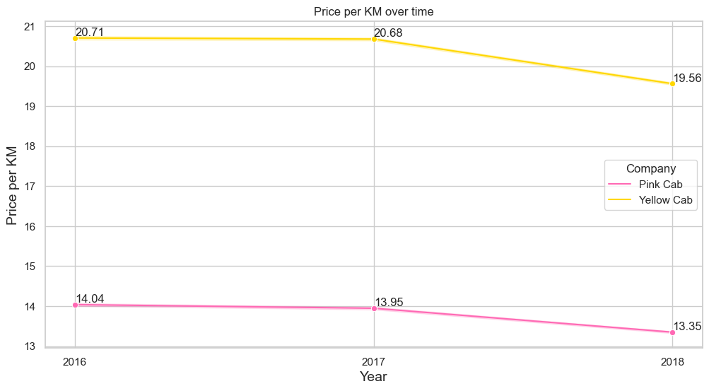
STATISTICS ON YEARLY CHANGES
The prices charged per KM are much higher for Yellow Cab than for Pink Cab, although the prices have been decreasing over time. The costs per KM have increased from 2016 to 2018, and the prices per KM have decreased, causing the Gap between prices and cost to narrow, reducing profits.
Addressing the gap between Costs and Prices, the percentage decrease from 2016 to 2017 and 2017 to 2018 is larger for Pink Cab than for Yellow Cab, which is alarming, because Pink Cab already has lower profits, however due to market competition, they are losing out on profits.
Unless Pink Cab widen their own customer base and build offices in other areas, they will suffer heavy losses

Slide 13
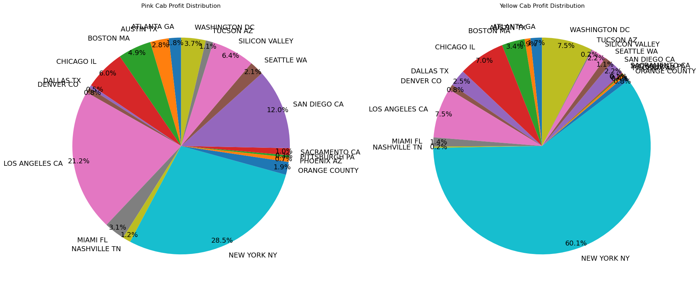
AREA-WISE COMPANY BY PROFIT
Out of Yellow Cab’s total Profits, over $25 million has been generated in New York

Slide 14
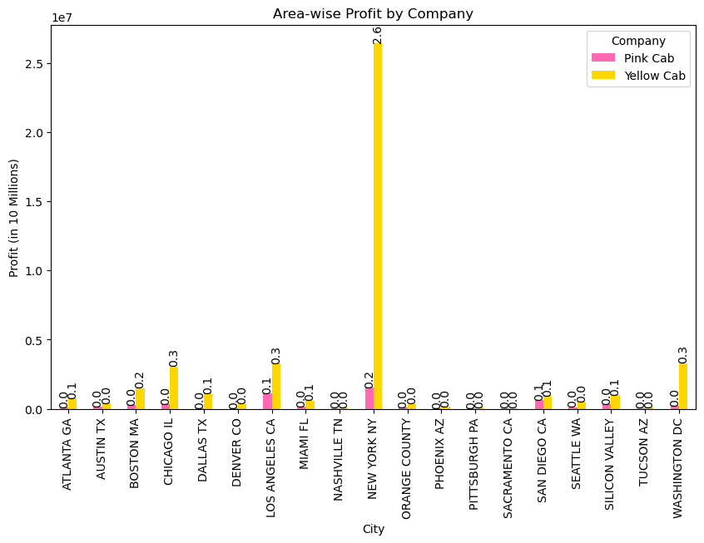
AREA-WISE COMPANY BY PROFIT
Pink Cab profits most in States on the West Coast, whereas Yellow Cab yields higher profits on East Coast States, with 60% being from New York.
Pink Cab has a wider spread/ distribution of where is generates its money, however most of Yellow Cab’s profits overall come from customers based in New York.
Despite Yellow Cab making significantly more Profits, Pink Cab may be a better investment in the long-run, since it’s customer base is more dispersed.
An economic crisis in New York can have a significant impact on the business, whereas Pink Cab’s coverage makes it a more stable investment.
Pink Cab’s Top 3 Profitable Areas: New York(28.5%), Los Angeles(21.2%), San Diego(12.0%)
Yellow Cab’s Top 3 Profitable Areas: New York(60.1%), Los Angeles(7.5%), Washington DC(7.5%)
Yellow Cab’s Sector in New York has an overall high Profit of $26 million, significantly higher than any other Company/ Area Sector.

Slide 15
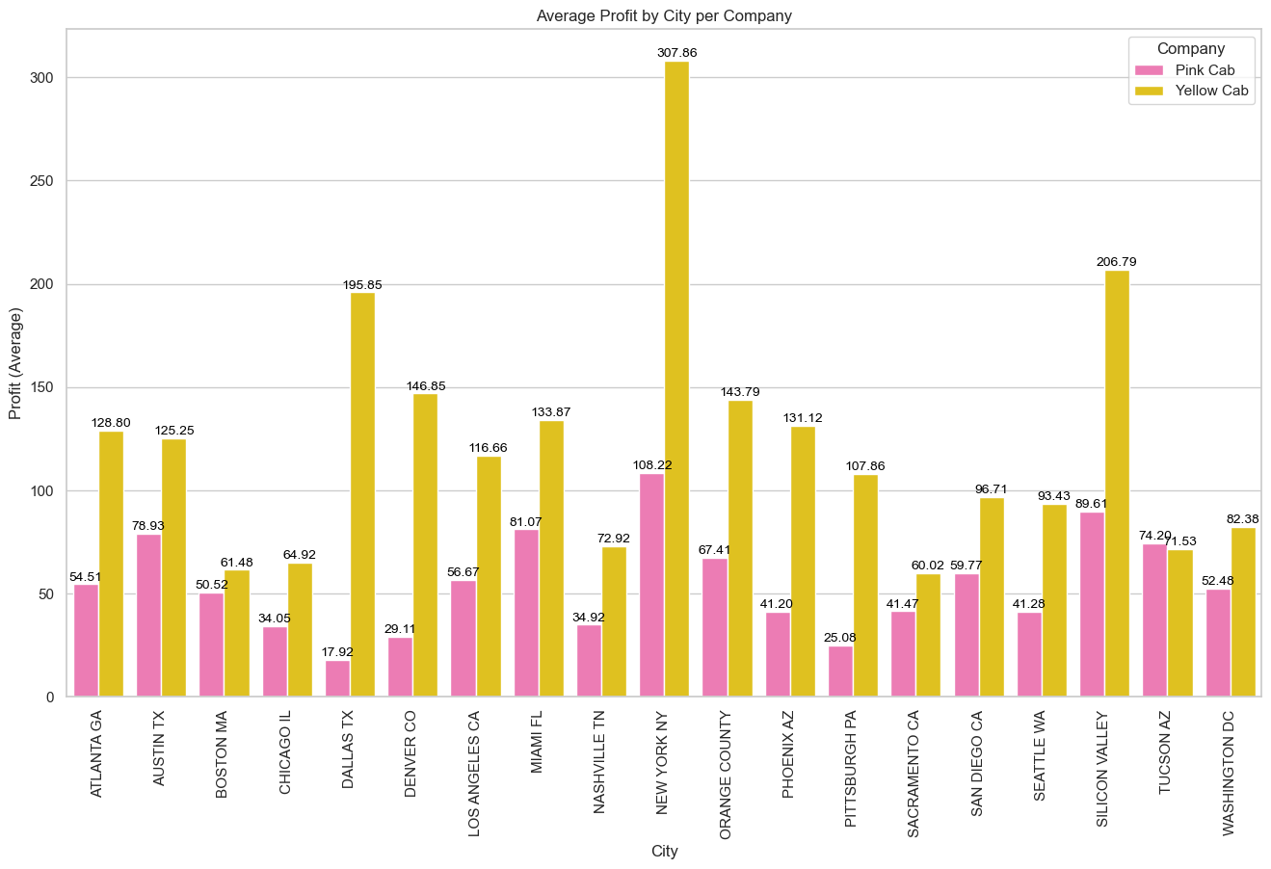
AVERAGE PROFIT BY COMPANY PER CITY
Both Pink Cab and Yellow Cab gain the most profit on average per each Ride journey in New York.
Other notable areas for Yellow Cab include Silicon Valley, Dallas Texas and Denver Colorado, with Pink Cab being in the same areas New York (NY), Silicon Valley and Miami Florida.
Pink Cab only makes more profit in Tucson Arizona than Yellow Cab on average.

Slide 16
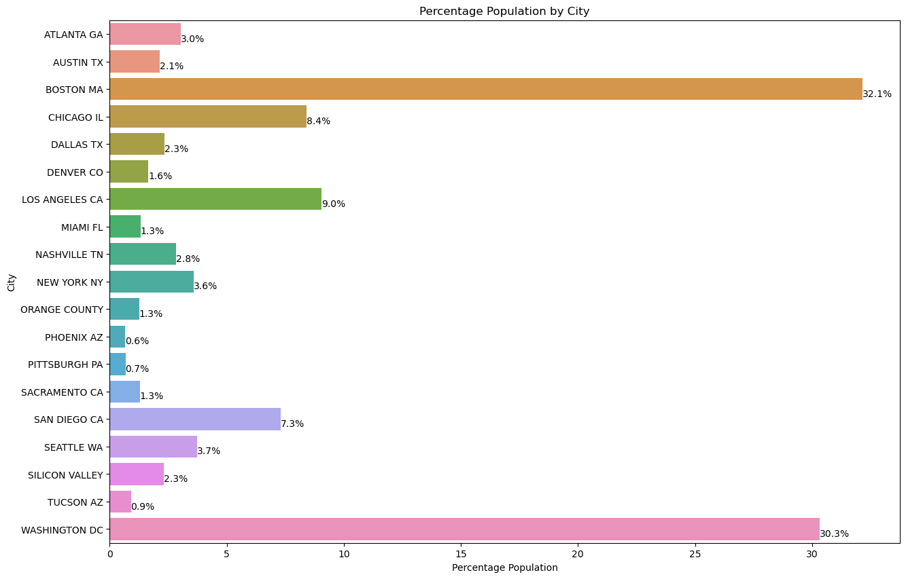
PERCENTAGE POPULATION BY CITY
Washington DC and Boston MA have the highest proportions of their Populations using these Cab Services.
In New York, despite the high Profits, only 3.6% of the population are using these services, perhaps due to a high number of rivalling Businesses but also good accessibility to other means of transport.

Slide 17
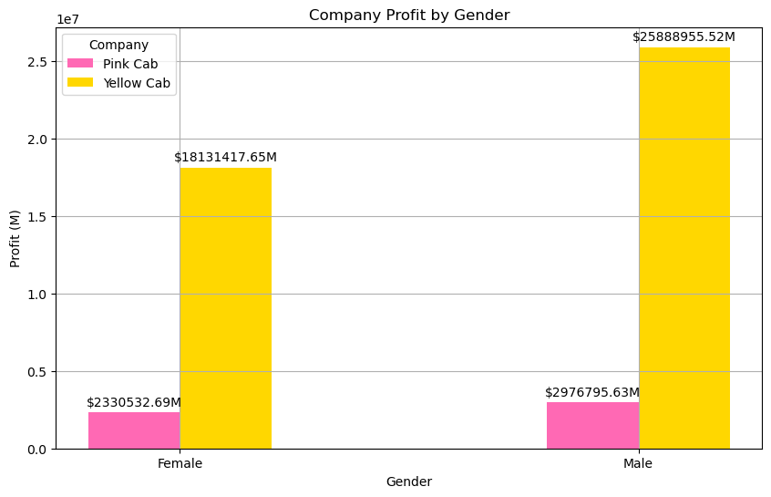
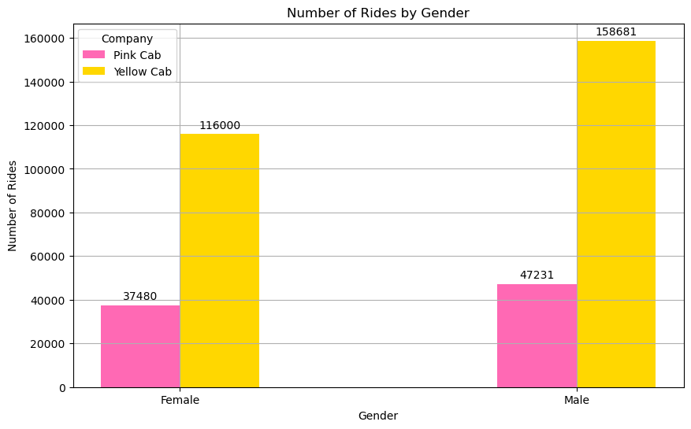
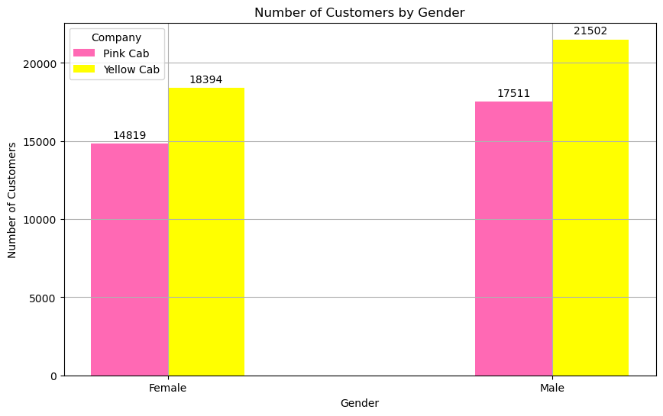
COMPANY X GENDER
Pink Cab has a more balanced Gender Transaction Ratio, with approximately 10,000 more Male customer rides, whereas Yellow Cab has approximately 40,000 more Male customer rides – This could indicate Male Customers are retained more, or they go on longer journeys.
In terms of Gender Ratio alone, we can agree that there is not much of an imbalance (baring in mind there are customers who use both services). There are noticeably more Men using the Yellow Cab Industry thank Pink, and similar pattern is observed for Women.
More males than females overall for both cab companies.
We can conclude that Yellow Cab Users have a larger number of rides, and draw in more profit for the company, indicating there is possibly greater Retention with this company.
Looking towards the right, we see the bars for the pink cabs increasing, so from our analysis we can say Pink Cab have a relatively high number of customers, however the number of rides these customers have had has been fewer than yellow cab, and the number of money the Pink Cab Industry make from these rides is even smaller.
Male Pink Cab Customers have an Average Profit per Ride of $63.02, whereas Female Pink Cab Customers have a Company Profit per Cab User of 62.18 (divide profit by number of rides). Male Yellow Cab Customers have an Average Profit per Ride of $163.15 whereas Female Yellow Cab Customers have an Average Profit per Ride of $156.31

Slide 18
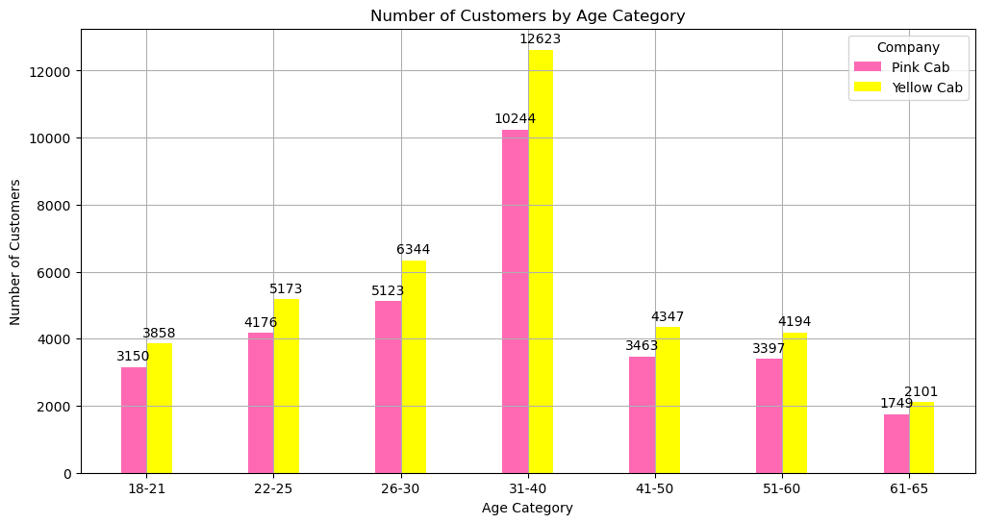
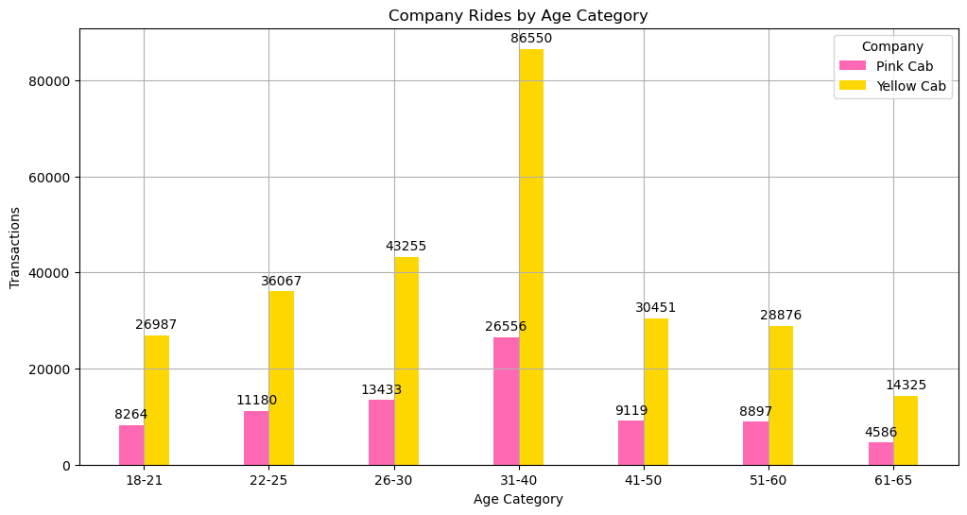
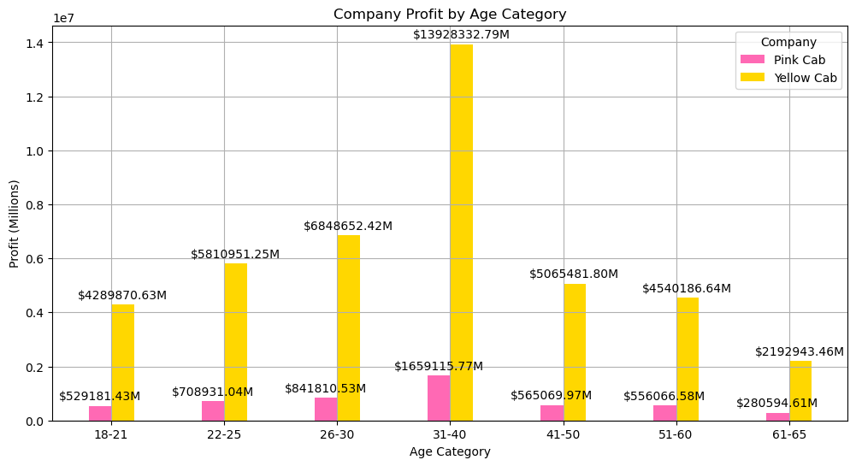
COMPANY X AGE CATEGORY
The highest number of customers are within the 33-40 Age Category and are working professionals.
The highest recorded profits for Yellow and Pink Cab’s lie within this age range, with Yellow Cab making almost double the profits within the 33-40 age range.
A smaller amount of the ageing population use these cab industries, and a higher proportion use the Pink Cab Company than any other age bracket.
By making inferences on our previous data, we can say most profits come from 33–40-year-olds and then 22-25- and 26–30-year-olds who are commuting to the city in New York.
Similarly, to the Company x Gender Analysis, we observe the height of Pink Cab Company bars becoming smaller in comparison with Yellow Cab Company bars, suggesting lower profits for cab rides, and less customer retention.
From this, we can conclude the Yellow Cab Company is a better investment for XYZ, due to its ability to generate larger profits of rides and provide better services for customers to reuse the service.

Slide 19
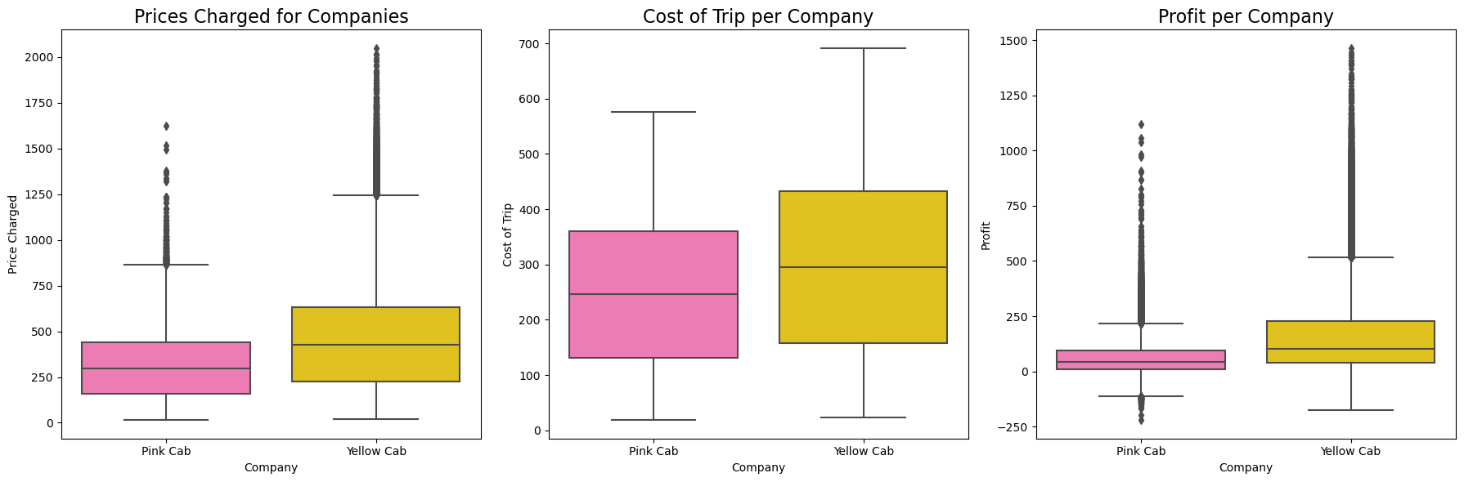
BOXPLOTS
There are a lot outliers for the prices charged for the taxi services and so therefore the profits per each company which suggests both Cab Services can do longer trips or trips in densely populated areas.
The median prices charged, costs per trip and the profit is higher for Yellow Cab than Pink Cab, suggesting that Yellow Cab charges higher prices, but their services are better hence the cost of the trips are higher. Another reason for a higher cost of trip could be simply because the length of Yellow Cab Customer rides is longer.
This tells us that Pink Cab should start chagrining higher prices to increase its profits and invest into better Cab services.

Slide 20
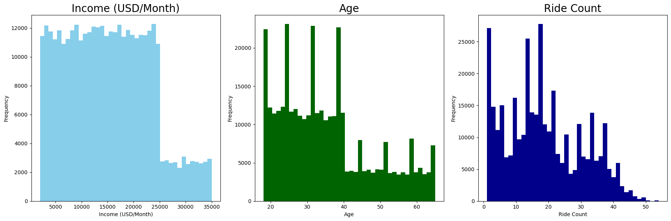
HISTOGRAMS
There is a drop within ages after 40, where the number of people using cab services decrease, perhaps suggesting both cab services are based in the City. To expand their businesses, they can look at expanding to rural areas with an ageing population, who are more in need of cab services. Within the current areas of operation, most customers are working professionals. A cause for concern, there are random jumps within each age range, suggesting errors with age data records.
The frequency of customers drops from around 23,000, showing a smaller number of users which earn an income over this.
Many customers only have one cab ride and proceed to not use cab services from either company again. Spikes in the Histogram suggesting there is a randomness in the number of rides per customer. However, as the number of rides increases, the frequency decreases highlighting only a few customers either use cabs consistently and are retained for a particular amount of time.

Slide 21
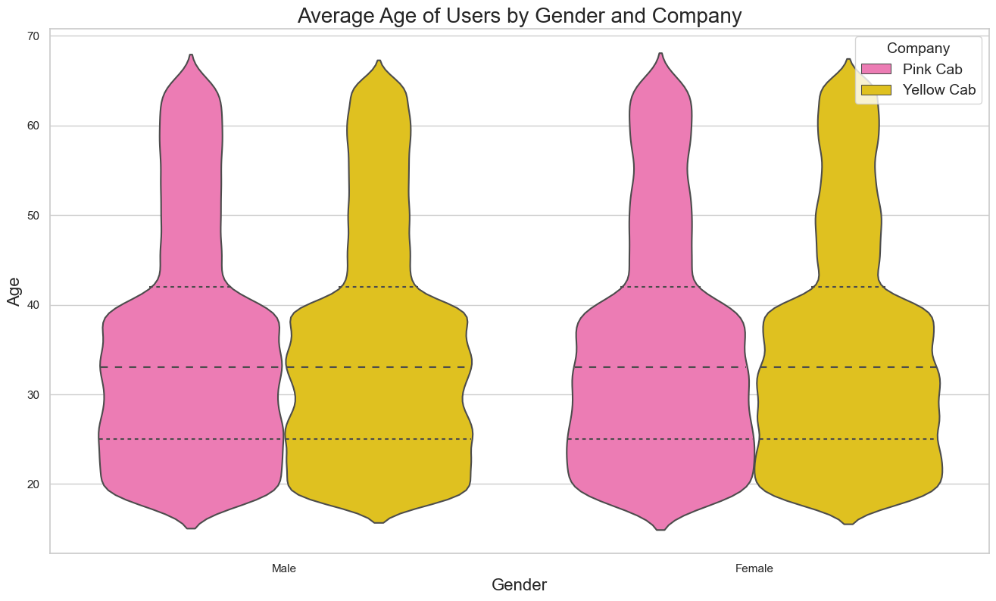
DISTRIBUTION OF AGES OF CUSTOMERS
The average age per both Genders is roughly 33 years, with a smaller proportion of Male users at from 28-32 years old than Female Users (observed via the dips in the Violin Plot).

Slide 22
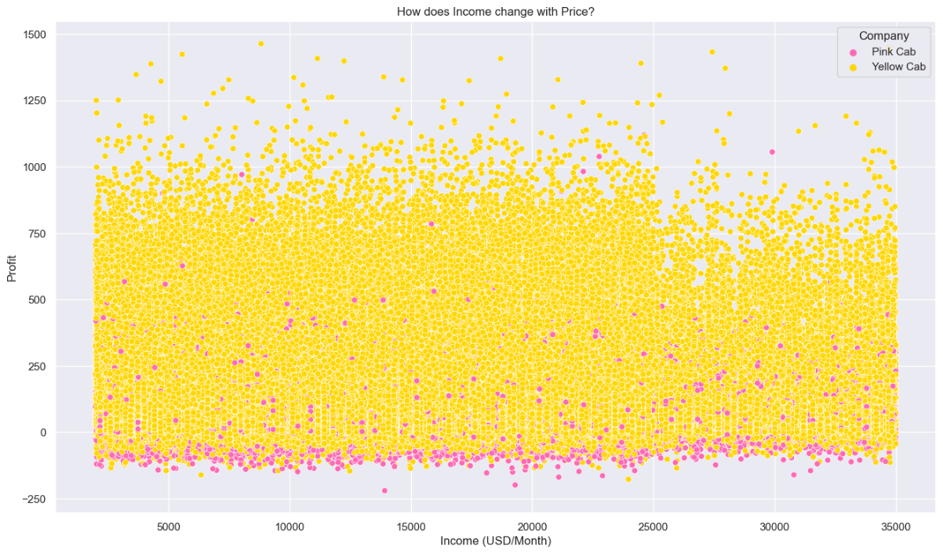
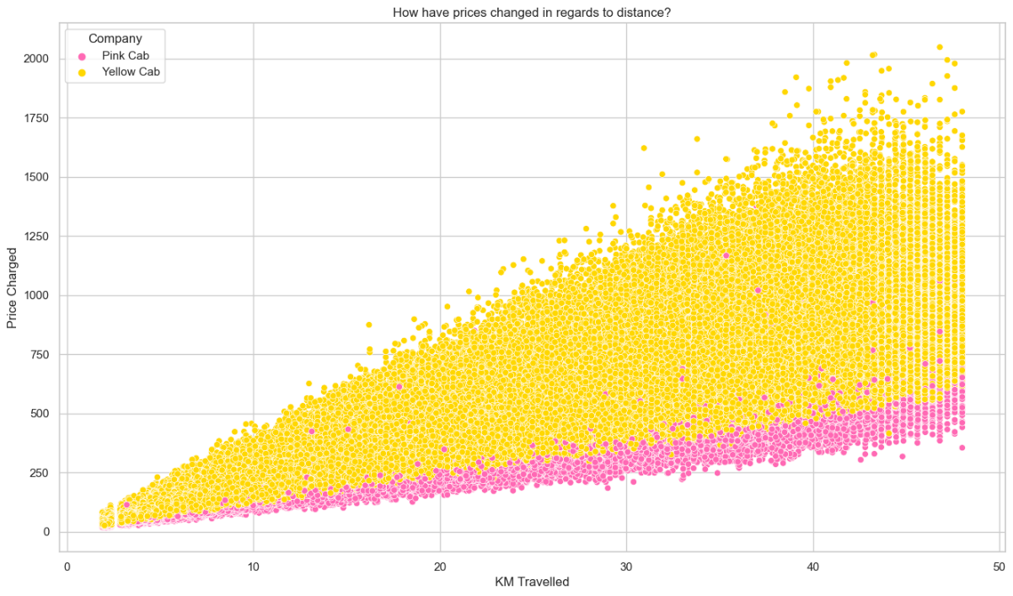
HOW PROFITS CHANGE WITH RESPECT TO INCOME AND DISTANCE?
There is no relationship between the Income changed in relation to the Prices Charged.
There is a linear relationship between the Prices Charged and the Distance travelled within a Cab Journey. As the KM travelled increases, the Prices charged decreases.

Slide 23
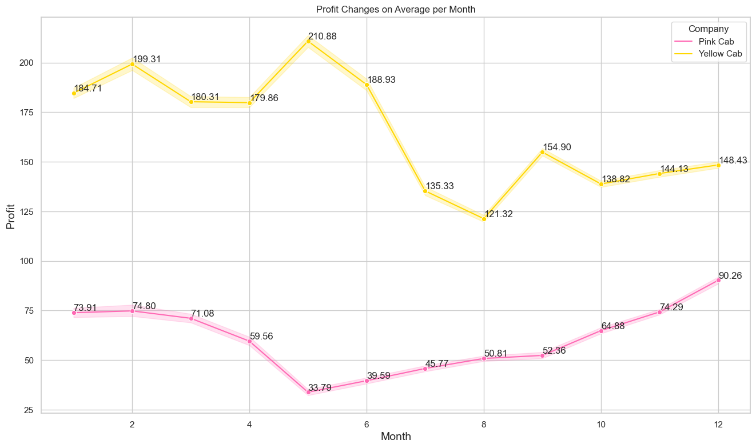
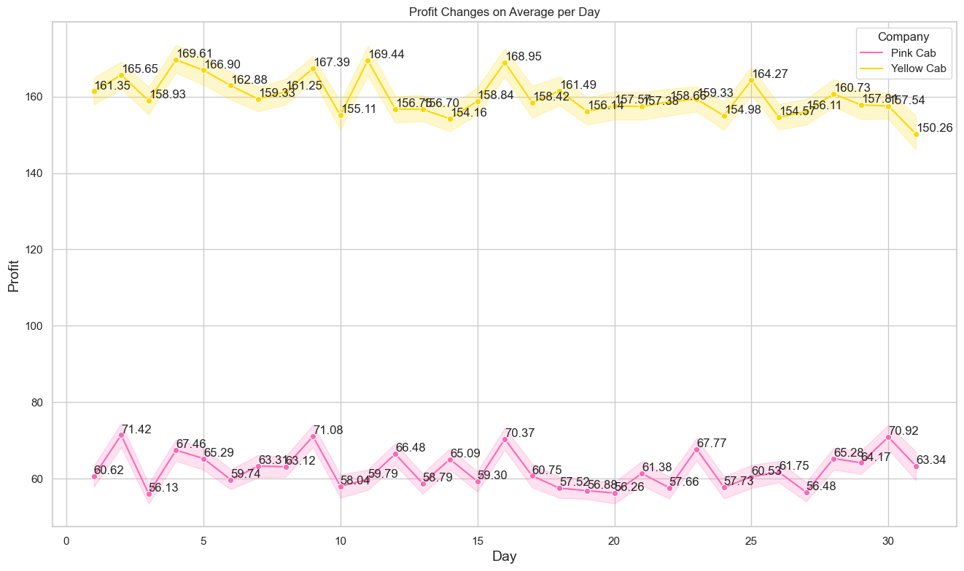
AVERAGE PROFIT BY COMPANY
Looking at Profit Changes on a Monthly Basis, we can see Yellow Cab’s profits reach an all time high in May at 210.88 on average, and a low in August, decreasing during summer months.
On the other hand, Pink Cab profits are at an all-time low in May, with the highest average Profits being in December at 90.26, therefore there is higher demand for this service offering cheaper prices in Christmas time.
Day to Day average profits are constantly fluctuating, Pink Cab Profits ranging from 56-72, and Yellow Cab ranging from 150-170 Profit wise.

Slide 24
FORECASTING RIDE COUNTS/ NUMBER OF CUSTOMERS/ PROFIT
Based on current performance of both cab companies, and forecasting the number of rides, the profit and the number of customers, we can see the number of rides and number of customers will be high for Yellow Cab next year. These numbers will be higher for 2019 than 2018.
However, the amount of profit will decrease over time, due to the prices charged per journey reducing and the costs per journey increasing.

Slide 25
HYPOTHESIS TESTING

Slide 26
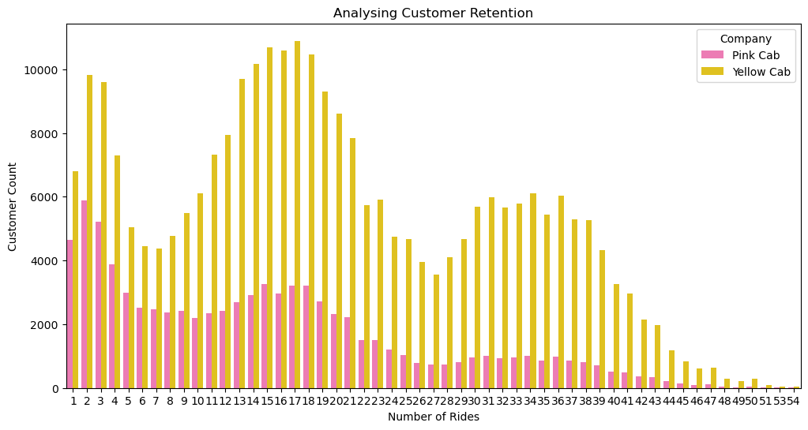
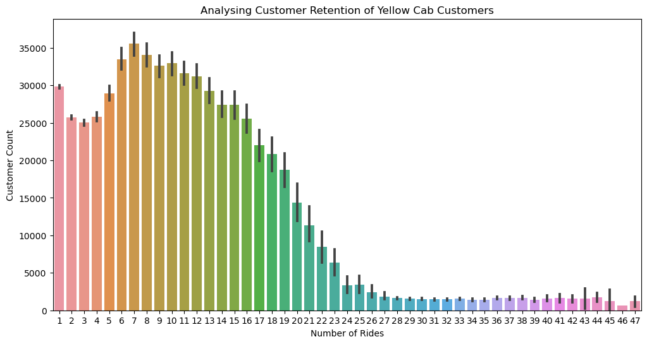
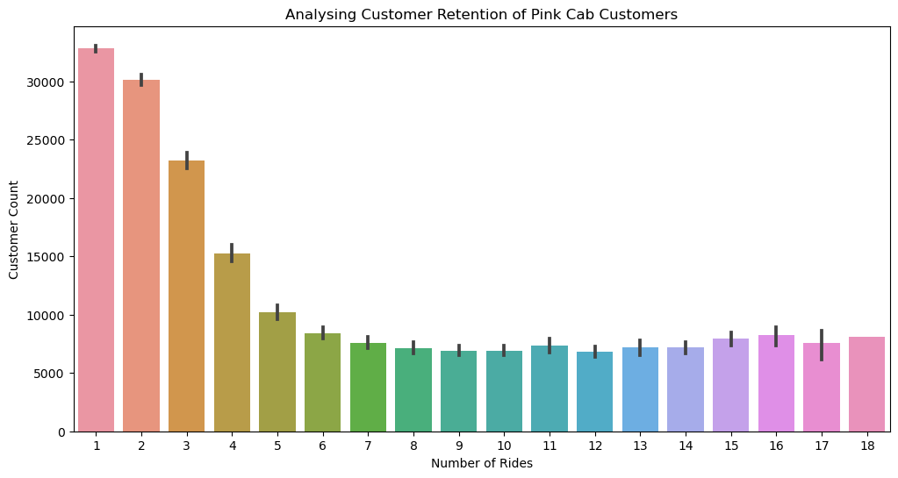
CUSTOMER RETENTION
Our first graph depicts Customers using both Yellow and Pink Cabs. We see that there are a significant number of users which use both cab services, and a higher number of customers per number of rides using Yellow Cabs.
When we separate the Data-Frames for each company, we observe that Yellow Cab “wipes the floor” with Pink Cab in terms of Customer Retention, with loyal customers using their services for up to 47 journeys, whereas the maximum number of Pink Cab journeys is 18.
Pink Cabs graph drops off after 1 ride and maintains a steady decline till 9 Number of Rides. On the other hand, Yellow Cabs customers show more brand loyalty, with the peak being 8 rides, indicating there is a much higher change if a customer uses Yellow Cab, they are likely to use it again.

Slide 27
HYPOTHESES TESTING
Hypothesis 1: Is there any difference in the KM travelled and price per KM?
HO: There is no difference in the KM travelled and the price per KM between the two companies.
H1: There is a difference in the KM travelled in relation to the price per KM between the two companies.
Hypothesis 2: Is there any difference between income (USD/ Month) and the distance for each journey?
HO: There is no difference between the two cab companies in terms of the income of the customers and the distance per journey.
H1: There is a difference between the two cab companies in terms of the income of the customers and the distance per journey.
Hypothesis 3: Is there any difference between income (USD/ Month) and the number of rides?
HO: There is no difference between the two cab companies in terms of the income of customers and the number of rides.
H1: There is a difference between the two cab companies in terms of the income of customers and the number of rides.

Slide 28
HYPOTHESES TESTING
Hypothesis 4: Is there a difference between Payment Mode and the income (USD/ Month)?
HO: There is no difference regarding Payment Mode based on the income of the customer in both cab companies.
H1: There is a difference regarding Payment Mode based on the income of the customer in both cab companies.
Hypothesis 5: Is there any difference in the Profit regarding the Age Category?
HO: There is no difference between the companies regarding Profit based on the Age in both cab companies.
H1: There is a difference between the companies regarding Profit based on the Age in both cab companies.
Hypothesis 6: Is there any difference in Profit regarding Gender?
HO: There is no difference between the companies regarding Profit based on Gender in both cab companies.
H1: There is a difference between the companies regarding Profit based on Gender in both cab companies.

Slide 29
EDA SUMMARY

Slide 30
CONCLUSIONS AND RECOMMENDATIONS
Conclusion 1 : Area Diversity
Based on the area diversity, Pink Cab is a better investment since it’s Profits are more spread out, and they do not rely heavily on one area sector unlike Yellow Cab which gets most of its profits in New York (60%). Yellow Cab needs to build its customer base in other areas, because if New York customers switch their cab company or suffer economic recession, Yellow Cab will accumulate bigger losses than Pink Cab.
Conclusion 2: Retention
In terms of Customer Retention, Yellow Cab retains its customers much more than Pink Cab, who have a higher number of customers which use the Cab Service only once and never again. On the other hand, more customers use the Yellow Cab service between 8-9 times indicating higher brand loyalty. This is perhaps due to their good customer base in New York. Yellow Cab is a much better investment in terms of retention.
Conclusion 3: Profit + Percentage Changes
In terms of Profit, we can see Yellow Cab generates much higher profits, due to increasing their prices charged per their journeys. Pink Cab may offer cheaper prices, however this is not efficient in trying drawing more customers. Pink Cab’s profits from their number of rides is low, making it a worse investment. Pink Cab should open offices in other areas where there are currently no users within the Geospatial Plot and increase their prices in these areas. Yellow Cabs make higher profits and are a better investment in this area.
Conclusion 4: Number of Rides + Percentage Changes
Pink Cab has a higher percentage increase and lower percentage decreases overall across the years for the number of rides than Yellow Cab, which is promising as they are a smaller cab company. In this aspect, Pink Cabs are a slightly better investment.
Conclusion 5: Number of Customers + Percentage Changes
Over 2017 and 2018, Pink Cabs feature a higher net percentage increase in the number of customers. Once again, Yellow Cab have a much higher number of customers, making it a better investment choice. Their customer counts are not decreasing significantly, so they will not stop making profits any time soon.
Conclusion 6: Forecasting
Both Yellow and Pink Cabs will make less profits but have more customers and rides.

Slide 31
RECOMMENDATIONS

Slide 32
DISCUSSION AND RECOMMENDATIONs
From our conclusions, my final recommendation would be to invest in the Yellow Cab company. Pink Cab has potential, if they set up offices in other areas and increase their prices, however currently Yellow Cab’s customer retention is the biggest contributing factor for this investment. Pink Cab has not proved why it is a better Company and why customers should choose them despite offering cheaper prices. Perhaps the quality of Yellow Cab cars are higher, and they are already a trust service in New York so they will continue to make profits yearly. More analysis could be done to compare customer retention each year for both services. One argument for Pink Cab is that if it increases its prices, it might be a better investment because it is experiencing more growth than Yellow Cab currently.

Slide 33
ANY QUESTIONS? FURTHER IMPROVEMENTS?
Thank You

